Slide 1
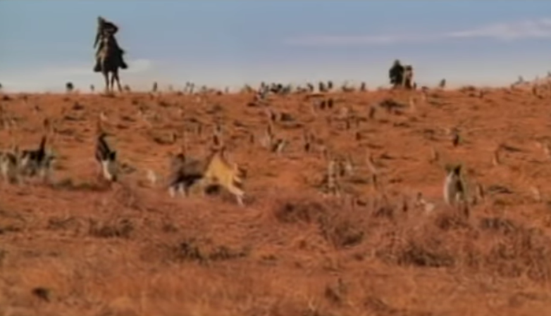

Slide 2
IS 201 Section 4: Introduction to Management Information Systems
Brandt Redd

Slide 3











Your Professor
https://brandtredd.org
Bollards

Slide 4
Your TAs
Bryce Cindrich
Dallin Fairbanks
Email: gaskin201TA@gmail.com and put the TA’s name in the subject line. (Bryce or Dallin)
Learning Suite – Content – TA Help
TA Lab – 290 TNRB (Next Door)
Work with them – you are 1 of 80 in this class and 1,138 across all sections.

Slide 5
Getting to know you…
Poll: https://bit.ly/2N1NG1B
Learning Suite – Content – Polls – Getting to Know You

Slide 6
Getting Help
My office hours: (time and location pending). In-person one hour a week and online virtual (Zoom) one hour a week. See: Learning Suite – Content – Office Hours
Order of Inquiry: MyEducator, Google, Classmates, TA’s, Professor
Email: brandtr@byu.edu Don’t email .xlsm files. They are blocked by most email systems.
Spiritual help: Bishop
Anxiety+ help: Student counseling, therapy, and social support

Slide 7
Course Information
Co-requisite: IS 110 (very easy 1 credit)
This class IS 201: 3 credit hour class ~~ heavy in waves
Use Learning Suite for schedule and grades
Use MyEducator for all content and submissions
Sign up link on Learning Suite schedule Day 1
Course slides posted and updated (after class) on: Learning Suite – Content – Slides

Slide 8
Course Materials
NO PAPER TEXTBOOK
MyEducator instead ($69)
Lots of (FREE) software through office.byu.edu and apps.byu.edu
MS Excel (Free at apps.byu.edu)
Data.World (Free online)
Data-visualization with Tableau (Free student account)
WebDev apps (Free or purchase) – Videos use Visual Studio which is free, also consider Brackets, Notepad++, others.

Slide 9
Assessment and Grading
Assessment | Total
Homework | 9.2%
MyEducator quizzes | 5.7%
Projects | 25.4%
Exams | 59.7%
Extra Credit | +1%
Curve | +/-???%
TOTAL | 100%
85.1%

Slide 10
Extra Credit
You can earn up to 1% extra credit toward your final grade
THAT’S A LOT!!!! 84% final grade becomes 85% final grade
Typos on MyEducator
Each typo is worth 2 points, up to 20 points total
Typos in class materials works too, but not on Admin slides or class announcements
Applying what you learn in class (DB/SQL, VBA, WebDev, Data Analytics) to a project at work or another venture
Maxed out extra credit (if merited)
Other Opportunities may be announced in class and reported on Learning Suite
See: Learning Suite – Content – Extra Credit

Slide 11
Learning Objectives
IS business application
Building and querying a data base
Data analysis
IS development
Notes:
IS business application: Understand the role of IS in organization architecture and strategy
Understand the roles of all types of enterprise information systems
Be aware of current trends in IT
Understand hardware and networking basics
Understand principles of data security and privacy
Building and querying a data base: Design, build, and query a database to apply correct principles of data storage and extraction.
Understand the fundamentals of relational databases
Create entity-relationship diagrams
Generate physical database based on ER diagram
Create queries based on a physical database in both design and SQL form
Data analysis: Understand the principles of business intelligence and be able to analyze data to support managerial decision-making.
Understand how to generate measures of business success
Use MS Excel to manipulate and analyze data (including Solver add-in)
Create pivot tables and pivot charts
Understand the difference between operational and analytical databases (data warehouses)
Use MS Excel and SQL Server Analysis Services to perform common data mining tasks
IS development: Understand how IS are created and maintained in an organization
Understand the IS project methodology and lifecycle
Be able to generate flowcharts modeling the business logic which IS should support
Generate basic HTML code in order to present structured information on the web
Use CSS to present the information in a professional format
Generate VBA functions to clean, manipulate, and analyze information including: navigation, boxes, conditionals, loops, and batch processing

Slide 12
Four Technical Languages…
SQL (Structured Query Language)
SELECT Name, Birthdate FROM Student WHERE City='Albuquerque'
VBA (Visual Basic for Applications)
Sub basic_messagebox() MsgBox "Hi there" End Sub
HTML
<title>Of this and that!</title>
CSS
title {
text-decoration: underline;
}

Slide 13
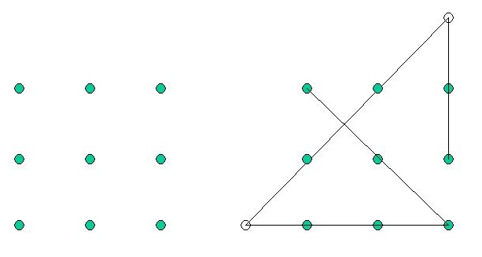

Unofficial Learning Outcomes…
TAKE INITIATIVE
Learn how to find answers to your own technology questions and solve your own problems
COOL UNDER PRESSURE
Learn how to work under pressure and time restrictions
PATIENCE (learn by study and by faith; D&C 88:118)
Learn how to be patient with yourself (and with the TAs and me)
EMBRACE CHANGE
Learn how to be adaptable
Notes:
Dot puzzle, goes with Patience: some things are completely baffling until they make sense, and then they are obvious.
BUNNY goes with embrace change: best laid plans of mice and men oft go awry

Slide 14

A Dilemma
We are training you for jobs that don’t exist yet, to solve problems that we don’t know are problems yet!

Slide 15
Things you will hear me (or TAs) say
I’m not sure; go figure it out and let me know.
I don’t know; Google it and tell me what you find.
Really? Wow! I learned something new!
Ask your neighbor; I’m sure s/he will be glad to help.
Whoa! I can’t believe that worked!
Oooh, I wonder if we can do it like this…?!
Well, that should have worked… Why didn’t it?
Notes:
This slide is to warn students that the professor simply cannot know everything and cannot anticipate every question in a field that is constantly changing. But that’s okay.

Slide 16
Daily Plan
Before class – EXPLORE
There are lots of prep materials on MyEducator. Don’t read every word unless that is how you learn best.
During class – LEARN AND PRACTICE
Bring laptop
Learn fundamentals
Engage in exercises and activities that synthesize and apply concepts and practice skills
After class – CONFIRM AND REVIEW
Quizzes, assignments, projects and exams, PRACTICE, PRACTICE, PRACTICE, PRACTICE, PRACTICE, PRACTICE, PRACTICE, PRACTICE

Slide 17
PRACTICE, PRACTICE, PRACTICE, PRACTICE, PRACTICE, PRACTICE, PRACTICE, PRACTICE, PRACTICE, PRACTICE, PRACTICE, PRACTICE, PRACTICE, PRACTICE, PRACTICE, PRACTICE, PRACTICE, PRACTICE, PRACTICE, PRACTICE, PRACTICE, PRACTICE, PRACTICE, PRACTICE, PRACTICE, PRACTICE, PRACTICE, PRACTICE, PRACTICE, PRACTICE, PRACTICE, PRACTICE, PRACTICE, PRACTICE, PRACTICE, PRACTICE, PRACTICE, PRACTICE, PRACTICE, PRACTICE, PRACTICE, PRACTICE, PRACTICE, PRACTICE, PRACTICE, PRACTICE, PRACTICE, PRACTICE, PRACTICE, PRACTICE, PRACTICE, PRACTICE, PRACTICE, PRACTICE, PRACTICE, PRACTICE, PRACTICE, PRACTICE, PRACTICE, PRACTICE, PRACTICE, PRACTICE, PRACTICE, PRACTICE, PRACTICE, PRACTICE, PRACTICE, PRACTICE, PRACTICE, PRACTICE, PRACTICE, PRACTICE, PRACTICE, PRACTICE, PRACTICE, PRACTICE, PRACTICE, PRACTICE, PRACTICE, PRACTICE, PRACTICE, PRACTICE, PRACTICE, PRACTICE, PRACTICE, PRACTICE, PRACTICE, PRACTICE, PRACTICE, PRACTICE, PRACTICE, PRACTICE, PRACTICE, PRACTICE, YOUROCK, PRACTICE, PRACTICE, PRACTICE, PRACTICE, PRACTICE, PRACTICE, PRACTICE, PRACTICE, PRACTICE, PRACTICE, PRACTICE, PRACTICE, PRACTICE, PRACTICE, PRACTICE, PRACTICE, PRACTICE, PRACTICE, PRACTICE, PRACTICE, PRACTICE, PRACTICE, PRACTICE, PRACTICE, PRACTICE, PRACTICE, PRACTICE, PRACTICE, PRACTICE, PRACTICE, PRACTICE, PRACTICE, PRACTICE, PRACTICE, PRACTICE, PRACTICE, PRACTICE, PRACTICE, PRACTICE, PRACTICE, PRACTICE, PRACTICE, PRACTICE, PRACTICE, PRACTICE, PRACTICE, PRACTICE, PRACTICE, PRACTICE, PRACTICE, PRACTICE, PRACTICE, PRACTICE, PRACTICE, PRACTICE, PRACTICE, PRACTICE, PRACTICE, PRACTICE, PRACTICE, PRACTICE, PRACTICE, PRACTICE, PRACTICE, PRACTICE, PRACTICE, PRACTICE, PRACTICE, PRACTICE, PRACTICE, PRACTICE, PRACTICE, PRACTICE, PRACTICE, PRACTICE, PRACTICE, PRACTICE, PRACTICE, PRACTICE, PRACTICE, PRACTICE, PRACTICE, PRACTICE, PRACTICE, PRACTICE, PRACTICE, PRACTICE, PRACTICE, PRACTICE, PRACTICE, PRACTICE, PRACTICE, PRACTICE, PRACTICE, PRACTICE, PRACTICE, PRACTICE, YESUCAN, PRACTICE, PRACTICE, PRACTICE, PRACTICE, PRACTICE, PRACTICE, PRACTICE, PRACTICE, PRACTICE, PRACTICE, PRACTICE, PRACTICE, PRACTICE, PRACTICE, PRACTICE, PRACTICE, PRACTICE, PRACTICE, PRACTICE, PRACTICE, PRACTICE, PRACTICE, PRACTICE, PRACTICE, PRACTICE, PRACTICE, PRACTICE, PRACTICE, PRACTICE, PRACTICE, PRACTICE, PRACTICE, PRACTICE, PRACTICE, PRACTICE, PRACTICE, PRACTICE,
Notes:
CAN YOU FIND THE TWO WORDS THAT ARE NOT PRACTICE?

Slide 18

Unit 1: Basics of Information Systems
Information Systems in Organizations
Hardware and Networking
Security and Privacy
Workload:

Slide 19

Unit 2: Data and Databases
Data Quality
Database Diagrams (ERDs)
Data.World (software)
Database Queries (SQL)
Workload:

Slide 20

Unit 3: Programming and Automation
Systems Development Lifecycle (SDLC)
Flowcharting
Programming with VBA
Workload:

Slide 21

Unit 4: Data Mining and Analytics
Tableau
MS Excel Solver
Statistics in Excel
Workload:

Slide 22

Unit 5: Web Development
HTML
CSS
Bootstrap, maybe Wix
Workload:

Slide 23
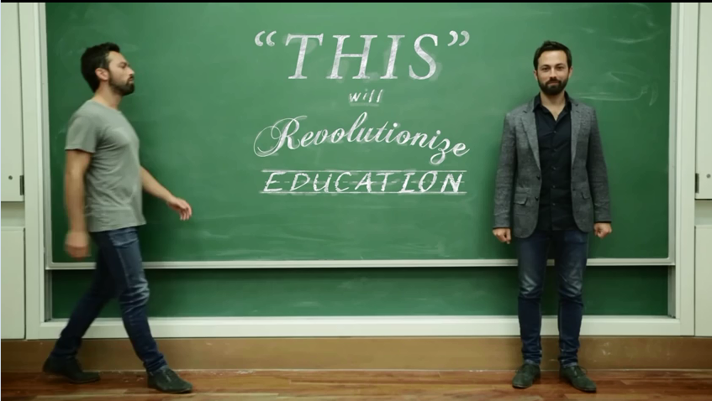
Notes:
A professor’s job is to INSPIRE the students to be fascinated in the content enough to put forth the effort to learn it. This link opens YouTube. Jump to 4:04 if insufficient time.

Slide 24
Today’s Lesson

Slide 25
Computer-Related Majors at BYU
Information Systems | Computer Science | Computer Engineering | Information Technology
College of Business | College of Physical and Mathematical Sciences | College of Engineering | College of Engineering
Information gathering, organizing, and managing. Supporting business processes such as operations, decision making and strategy. Emphasis on databases and analytics. A focus on practical applications in business. | The theory and art of computer programming. Focus on software, logic, data structures, and communications. Database theory and implementation. Both practical and theoretical work. | Emphasis on computer hardware and the software that controls it. Digital communications, peripheral devices, input/output, and robotics. Includes practical work and theoretical research. | Deployment and support of data infrastructure. Systems administration. Includes deploying servers, data communications, networking, cybersecurity, redundancy, and operations.
Notes:
Who would: Design a new drone to follow you and take videos of what you do. Prepare a database to track sales and produce weekly reports.
Create your email account and grant you access.
Write a device driver for a new high-resolution mouse.
Invent and deploy a new internet search algorithm.
Build a website with interactive elements and services
Install the latest security patches on the servers without interrupting operations.
Search a database for the all customers in Oklahoma who have purchased hail insurance
Write your new, revolutionary, mobile application.
Design the Spin electric scooter.
Write the software app for the mobile phone that lets you rent a Spin scooter.
Deploy the servers that monitor where the Spin scooters are located.
Analyze the data to figure out which demographics are most likely to rent a Spin scooter.

Slide 26
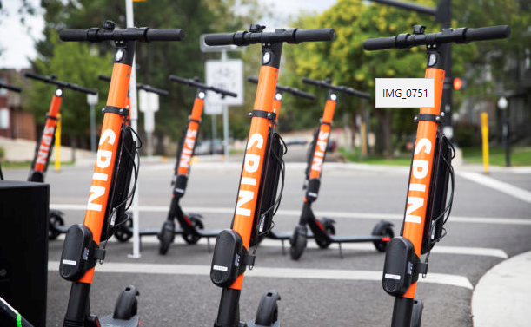
Who Would...
Someone who majored in:
Information Systems
Computer Science
Computer Engineering
Information Technology
Notes:
Who would: * Design a new drone to follow you and take videos of what you do. * Prepare a database to track sales and produce weekly reports.
* Create your email account and grant you access.
* Write a device driver for a new high-resolution mouse.
* Invent and deploy a new search algorithm.
* Build a website with interactive elements and services
* Install the latest security patches on the servers without interrupting operations.
* Search a database for the all customers in Oklahoma who have purchased hail insurance
* Write your new, revolutionary, mobile application.
* Design the Spin electric scooter.
* Write the software app for the mobile phone that lets you rent a Spin scooter.
* Deploy the servers that monitor where the Spin scooters are located.
* Analyze the data to figure out which demographics are most likely to rent a Spin scooter.

Slide 27

Information systems are the combination of technologies and people through which information is gathered, organized, and analyzed.
Information systems work is the art of solving unstructured business problems with technology.
People
IS
Organization
Technology

Slide 28













Slide 29
Types of IS
Sustaining IS
Support core business processes
Need to process data quickly/accurately
University website… Other examples???
Strategic IS
A source of creative strategy that differentiates market leaders
Should help to generate new knowledge that can be used to…
…make tough judgment calls
…decide whether to enter or exit markets
…decide which product/service lines to enter or exit
…decide which technology/business paradigms to use
Examples of strategic IS????
Notes:
Sustaining IS examples are easy. Strategic IS examples are much more difficult because we don’t know about a lot of them – and that’s what gives them a competitive advantage.

Slide 30
What will you learn in this class?
You will learn the lifecycle of data
data → information → knowledge → business intelligence
You will learn:
The core technologies that make this progression possible
The conceptual principles that apply regardless of the technologies used
Some (lots of) skills to help you extract data, structure information, create knowledge and produce business intelligence
Sustaining IS
Strategic IS

Slide 31
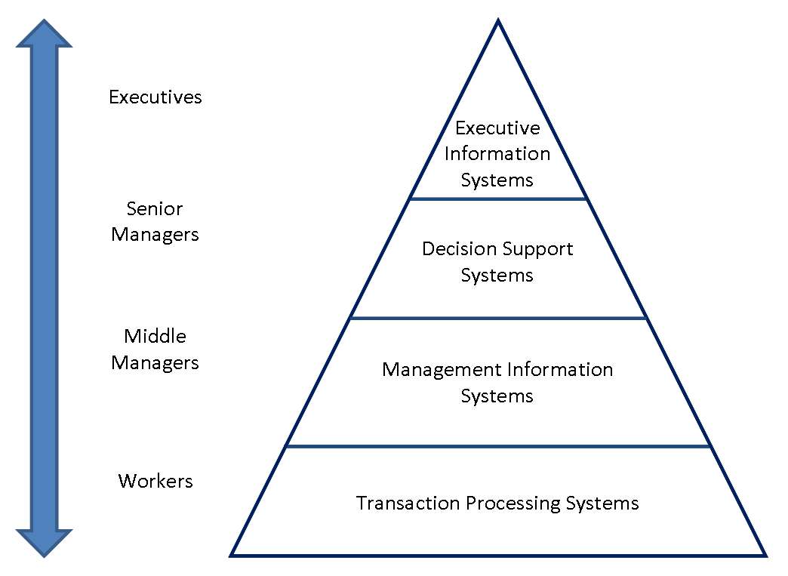
Types of IS
Strategic
Sustaining

Slide 32
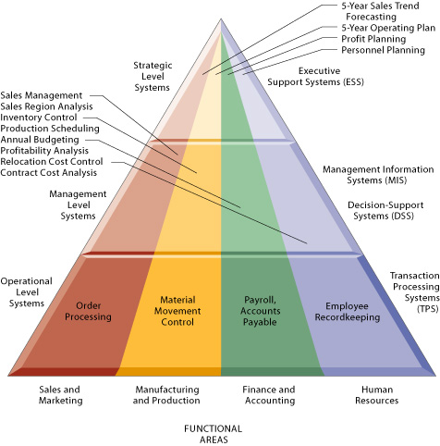
Information systems are everywhere

Slide 33
Enterprise Resource Planning (ERP)
Tier 1 venders (high complexity, high cost, used in many industries, international, global multi capabilities) | Tier 2 venders (medium complexity, medium cost, vertical industry focused, international) | Tier 3 venders (limited functionality, lowest cost, vertical industry focused, used by small companies)
Oracle | abas-USA | Aptean
SAP | Cincom | Acumatica
 | Fujitsu | Exact Americas
 | IBS | Expandable
 | IFS | Global Shop Solutions
 | Infor | HarrisData
 | IQMS | OmegaCube Technologies
 | Microsoft Dynamics | Smarter Manager
 | NetSuite | Solarsoft Business Systems
 | Plex Systems | Syspro
 | proALPHA | Visibility
 | Pronto | xTuple
 | QAD
 | Ramco
 | Sage Software
 | Technology Group International
Notes:
The point of this slide is just to show the competitors and players. You don’t need to memorize these, but if someone says “SAP” or “Oracle”, you should know what they are talking about.

Slide 34
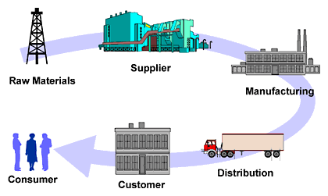
Supply Chain Management (SCM)
Prevents the bull-whip effect
Over estimating consumer demand, resulting in inflated production
Sustaining (TPS) for SCM?
Strategic (MIS/DSS/EIS)?
Where are the:
People
Organizations
Technology
Notes:
Sustaining (TPS) for SCM?
Inventory tracking
Strategic (MIS/DSS/EIS)?
Inventory forecasting

Slide 35
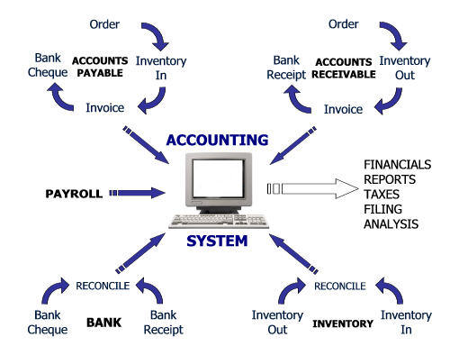
Accounting Information Systems
Sustaining (TPS) for AIS?
Strategic (MIS/DSS/EIS)?
Where are the:
People
Organizations
Technology
Notes:
Sustaining (TPS) for AIS?
Payroll system
Strategic (MIS/DSS/EIS)?
Financial forecasts and strategic investments and acquisitions system

Slide 36
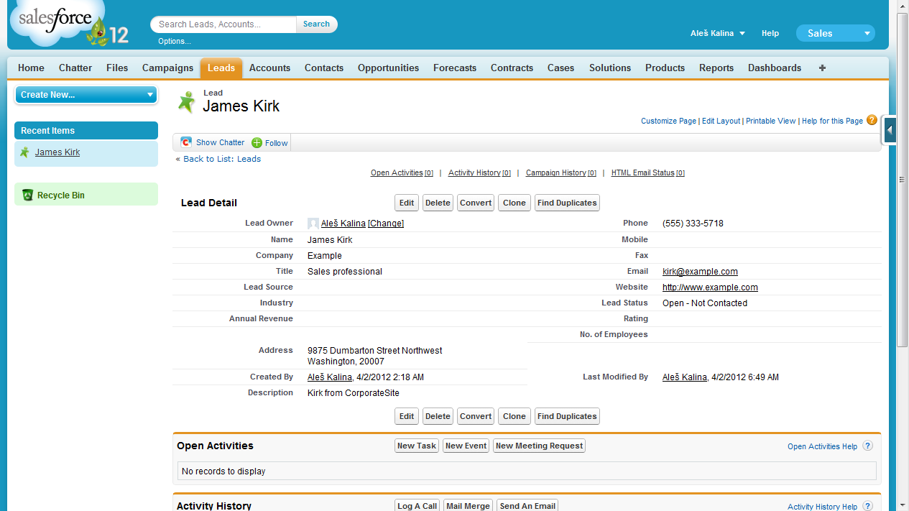
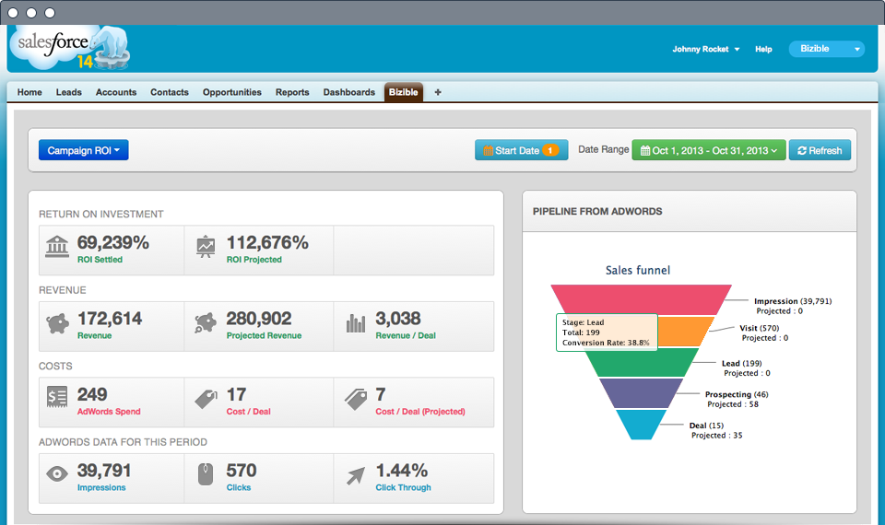
Customer Relationship Management (CRM)
Where are the:
People
Organizations
Technology
Sustaining (TPS)
Strategic (MIS, DSS, EIS)

Slide 37

IS is all about unstructured problems
In small groups (3-5 per group), design a mutually beneficial (to customers and providers) solution to the following customer problem:
“I often struggle to locate items on my list when I go to the store.”
Remember:
People
Organizations
Technology
Notes:
The clock is to indicate that we’ll do this if we have time.

Slide 38
The awesomeness of IS
What’s different?
Unstructured Problems
Often no existing solutions – Multiple solutions possible
Use or create tools to creatively solve problems
How should this affect you?
Focus on tools rather than “memorizable” solutions
Most of the course is based on tools and skills rather than memorizing formulas and book readings
Prepare for exams by practicing rather than memorizing practice-problems
***Some concepts and key terms will still need to be memorized in order to establish intelligent/educated conversing skills in the workplace (and in interviews)
Notes:
Help them understand the IS is all about unstructured problem solving. There is no ONE BEST solution for every problem. They will often face problems that have never been solved.
This is very different from accounting. Accounting is government-regulated. There is a given answer for every problem. Creativity is not encouraged (leads to cooking the books and corporate loopholes).

Slide 39
Career Opportunities in IS
Awesome
V
http://isjobindex.com/
Be one of these:
At one of these:
Web developer
Consultant
Systems designer
Project manager
CTO, CIO, CSO
App designer
Mobile developer
Database architect
…so many more…
Apple
Google
Facebook
Adobe
Microsoft
ExxonMobil
KPMG, EY, PWC
Pepsi Co.
…so many more…
Notes:
39

Slide 40
Base Salary and Placement Info 2019
BS in IS
Avg Base Salary $63,504
Placement 100%
MISM
Avg Base Salary $80,868
Placement 100%
PhD in IS (not offered at BYU)
Avg Base Salary $150,000+
Placement in top PhD programs 100%
See Reid Grawe, grawe@byu.edu, IS career placement coordinator, 436 TNRB, 801-422-1823, for further information about these statistics and the actual companies who hire.
See Stan Wilson stanley_wilson@byu.edu, Marriott School Undergraduate Advisor, 460 TNRB, for further information about the IS degree program, requirements, etc.
See James Gaskin james.gaskin@byu.edu about the pre-phd program.
Notes:
40

Slide 41
2017

Slide 42
2017
MISM and MAcc require only 1 year beyond bachelors
Requires minimum of five years work experience after bachelors

Slide 43
Want to apply to IS?
IS Majors need IS 110, IS 201 & IS 303 or CS 142 by June 30th of the applying year.
***Also, don’t make a bad impression***
(IS303 and CS142: Intro to Programming) B or better
(IS201 intro to IS) B or better
(IS110 Spreadsheets and computing)

Slide 44
Resume by end of Semester
Topic or Skill | Level of Mastery (1=novice; 5=Expert)
ERPs | 1
Data Security and Privacy | 1
Database Modeling and Design | 2
SQL | 3
Pivot Tables & Pivot Charts | 5
Solver (optimization with Excel) | 4
Statistics in Excel, including prediction | 3
Tableau (data analytics and visualization) | 4
Web Development (HTML CSS) | 3
IT/IS Project Management | 1
Flowcharting | 3
Excel Automation (VBA) | 4

Slide 45


This class can be HARD…
very
V
Elder Henry B. Eyring:
“[BYU] is a vibrant and determined community of learners and lifters.”(discuss group work policy)
BYU Mission statement:
“The mission of Brigham Young University …is to assist individuals in their quest for perfection and eternal life. That assistance should provide a period of intensive learning in a stimulating setting where a commitment to excellence is expected and the full realization of human potential is pursued.”
BYU AIMS:
“BYU seeks to develop students of faith, intellect, and character who have the skills and the desire to continue learning and to serve others throughout their lives.”
Notes:
For some the class will be hard, but for others it will be a breeze.

Slide 46
Class Value

Slide 47

Is IS the right path for me?
Unstructured problems
Create and invent
Explore and discover
Embrace the unknown
Rapidly changing field
Unmet demand for jobs

Slide 48
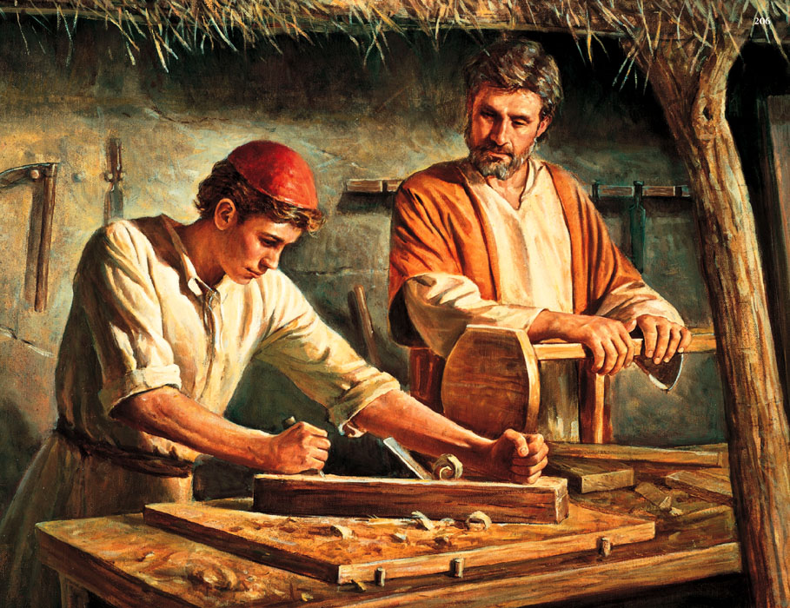
Notes:
Working in the field of information systems is a lot like working as a carpenter. You learn tools, not solutions. As you practice with the tools, you get better at using them and you can tackle ever-more sophisticated problems with greater elegance. If you only know how to craft a particular kind of chair exactly the same way your mentor showed you, then you are a lousy carpenter.

Slide 49
Knowledge and Intelligence
Whatever principle of intelligence we attain unto in this life, it will rise with us in the resurrection. And if a person gains more knowledge and intelligence in this life through his diligence and obedience than another, he will have so much the advantage in the world to come.
(D&C 130:18-19)
Data is innately stupid and useless, and cannot increase knowledge and intelligence, unless you know how to store, extract, analyze, and interpret it.
THAT’S WHAT THIS CLASS IS FOR ☺

Slide 50
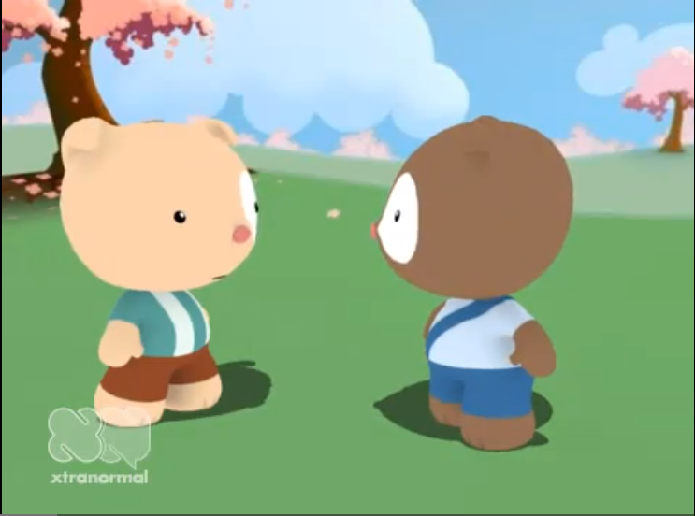
Stay on top of things
5 min
Notes:
If there’s time (but there probably won’t be

